Slide 1
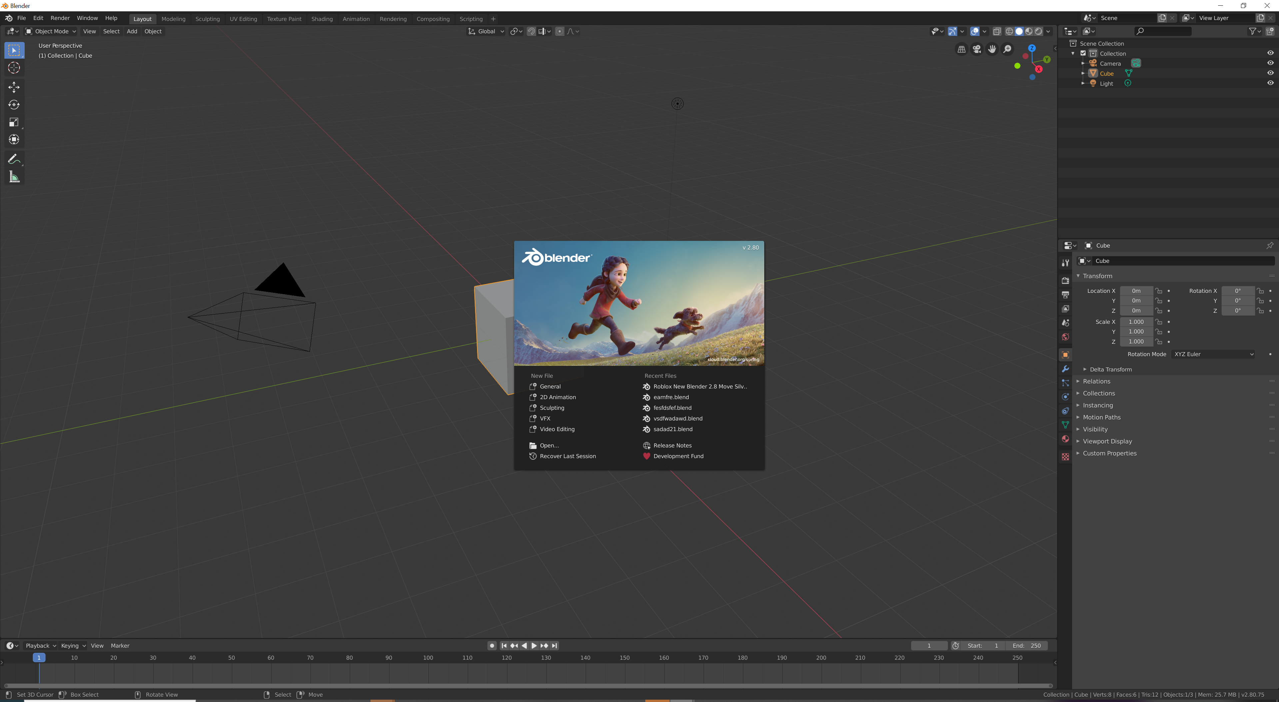
Introduction to Blender for Construction
Introduction to Blender for Construction
Enhancing the Construction Process with 3D Modeling and Visualization
Enhancing the Construction Process with 3D Modeling and Visualization
By:- Sandeepkumar R Verma
CRN:- 2114056
URN:-2103997

Slide 2
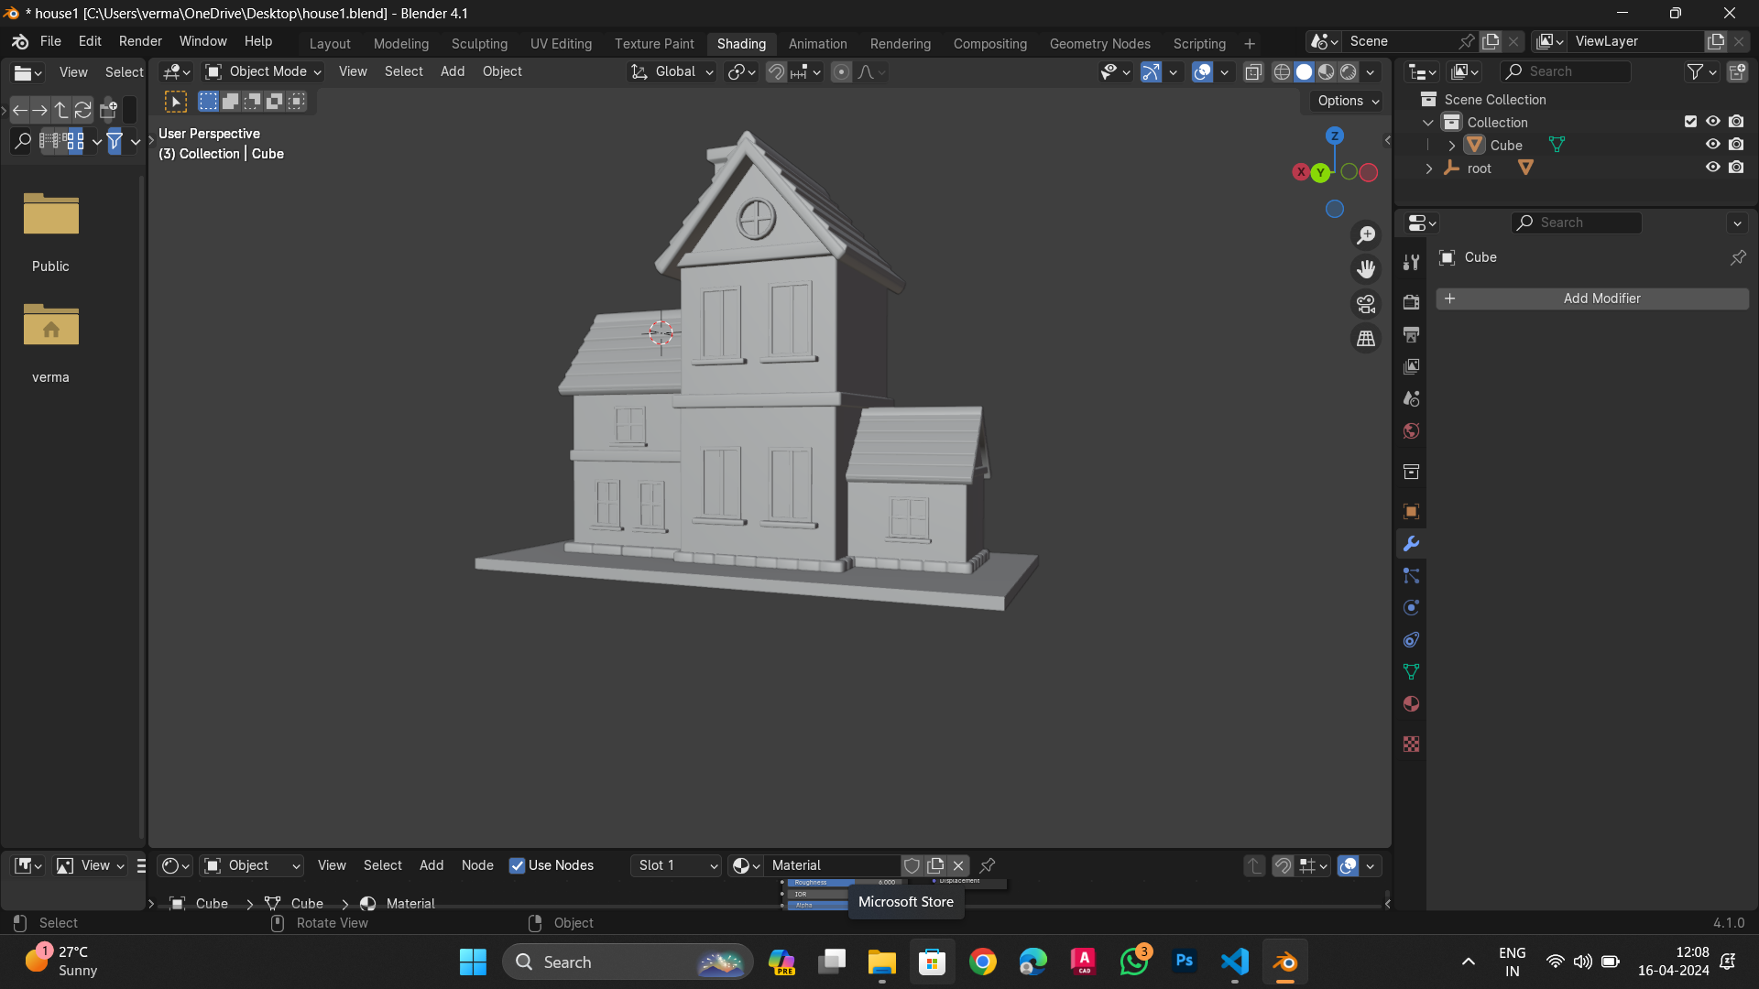

Slide 3
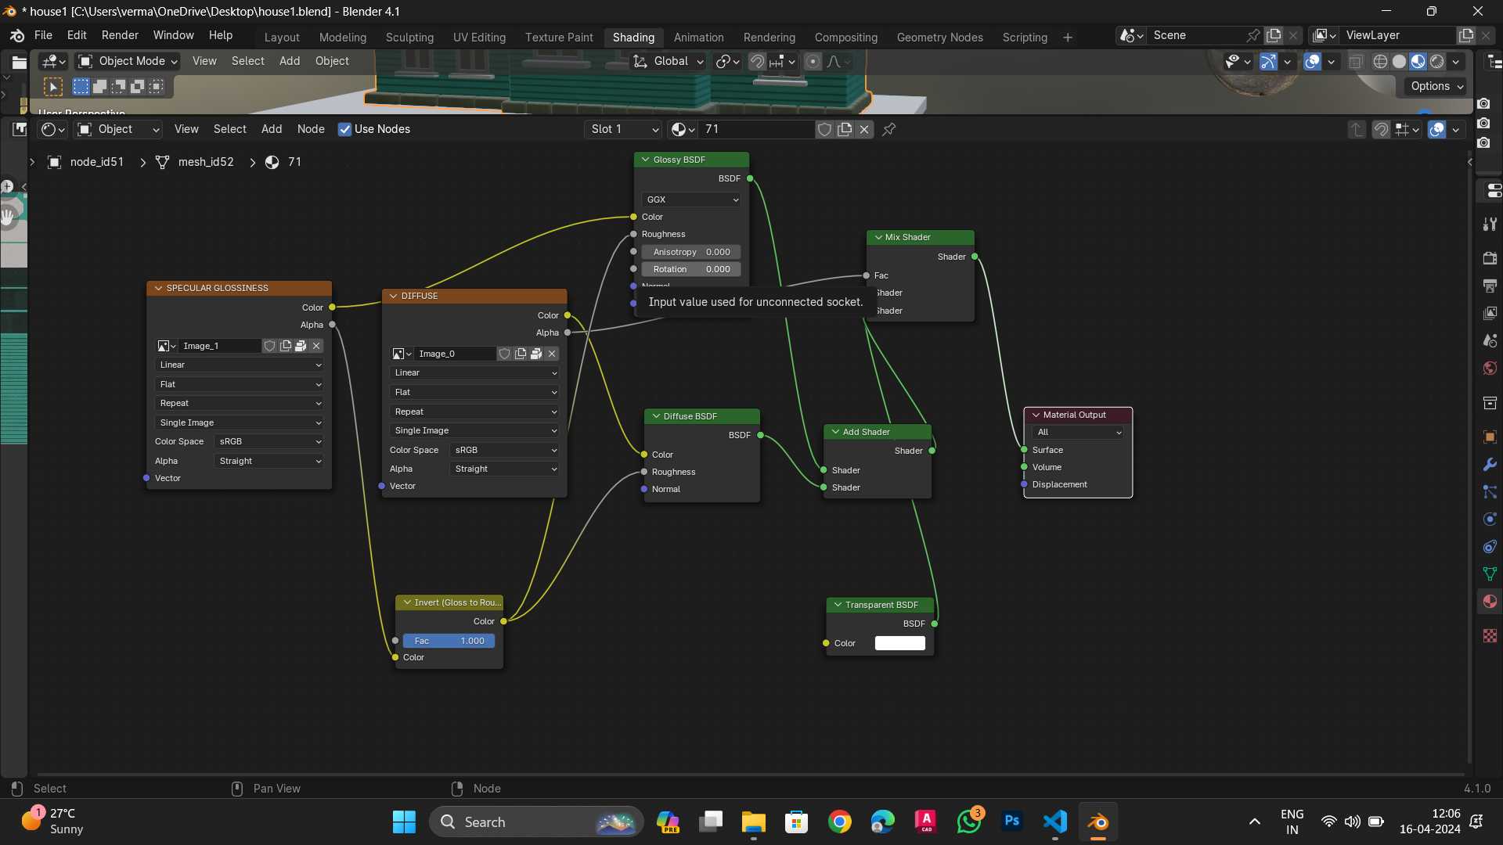

Slide 4
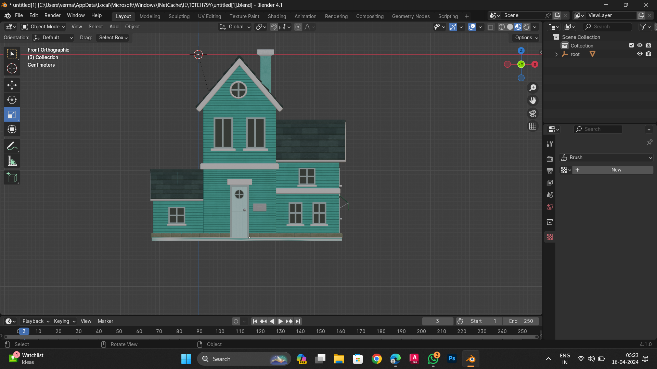

Slide 5
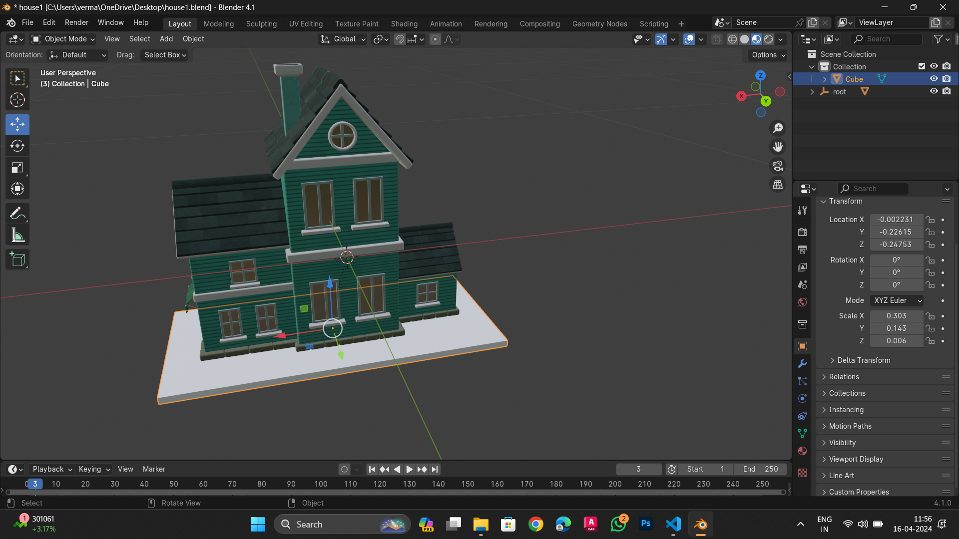

Slide 7
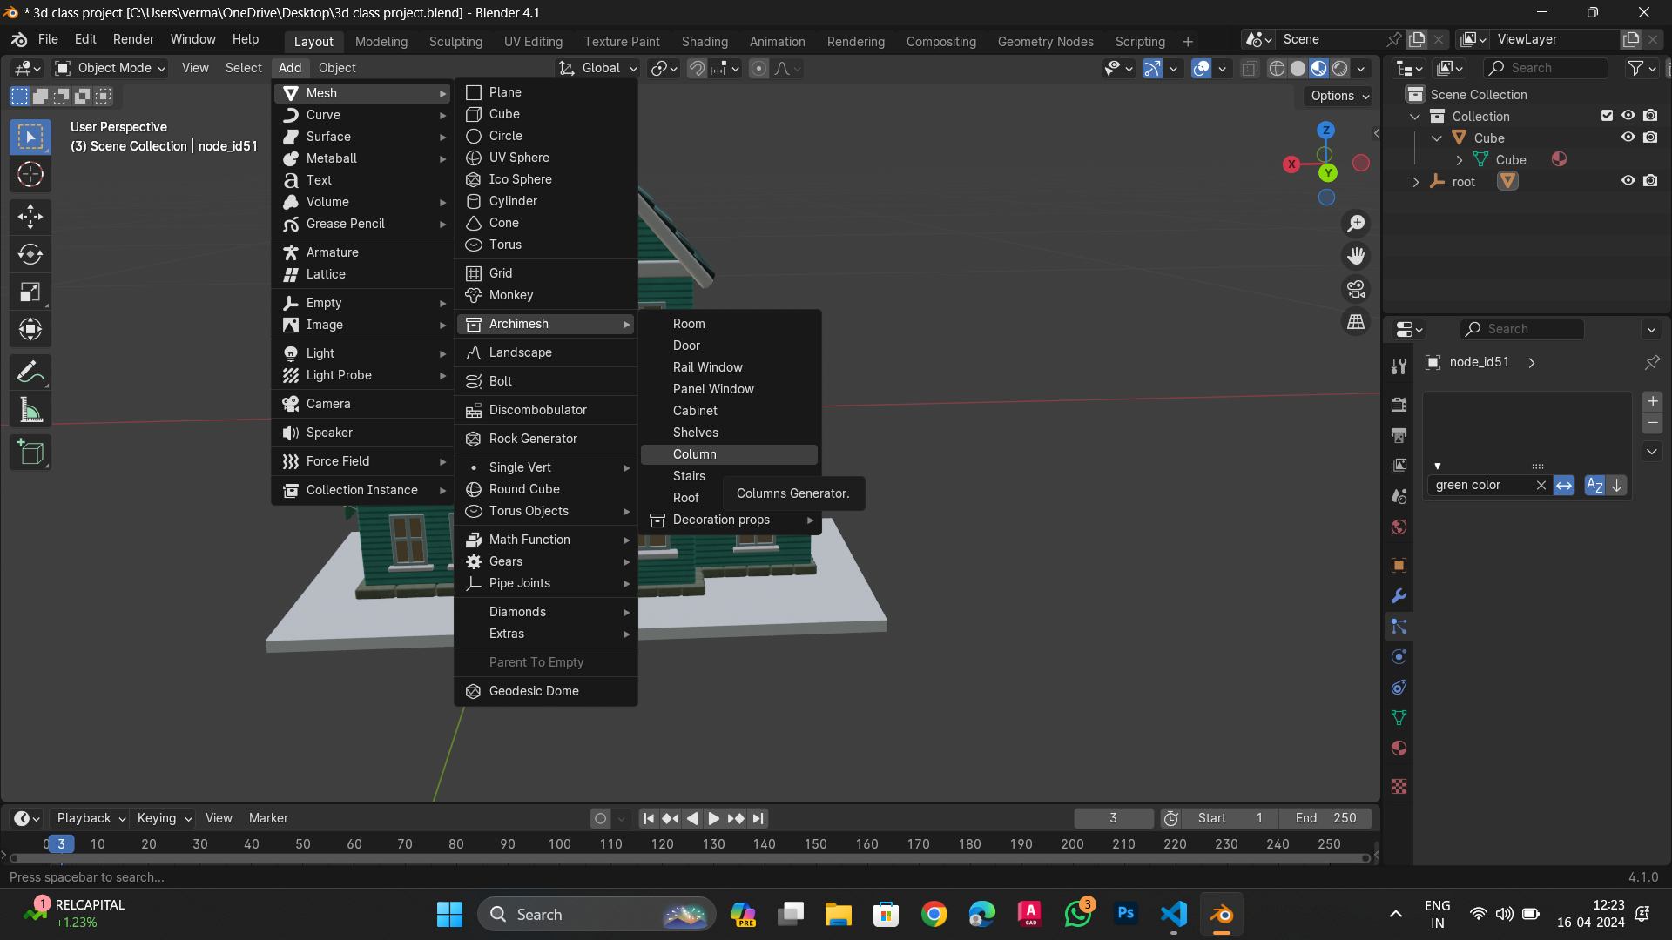

Slide 8
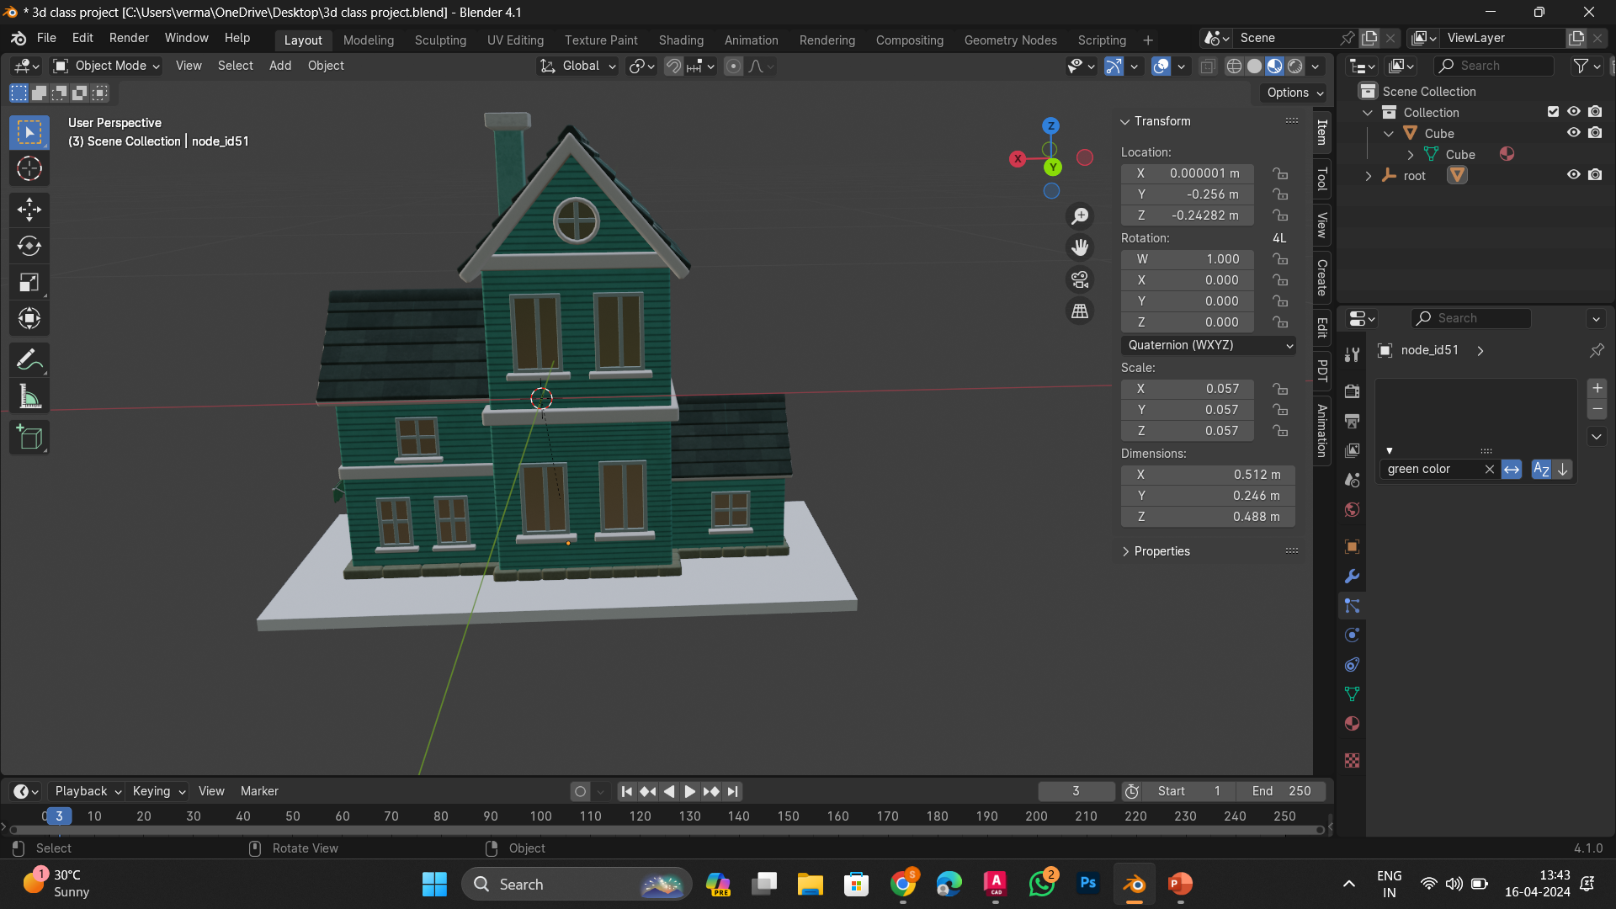

Slide 9
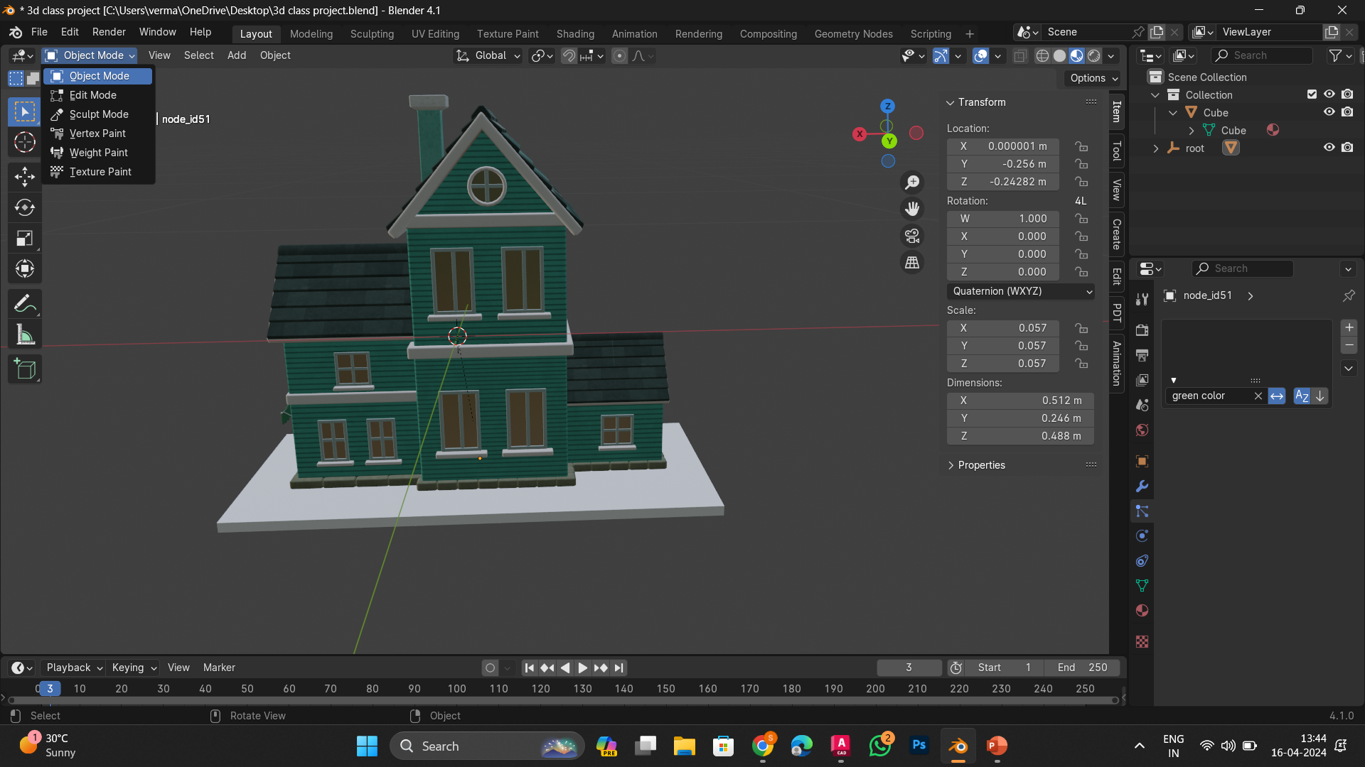

Slide 10
